Slide 1

SYNOPSYS TOOLS GUIDELINES
ĐẠI HỌC QUỐC GIA TP.HỒ CHÍ MINH
TRƯỜNG ĐẠI HỌC BÁCH KHOA
KHOA ĐIỆN-ĐIỆN TỬ
BỘ MÔN KỸ THUẬT ĐIỆN TỬ

Slide 2
AGENDA
Design Flow
Circuit Design Guidelines
Layout Design Guidelines

Slide 3
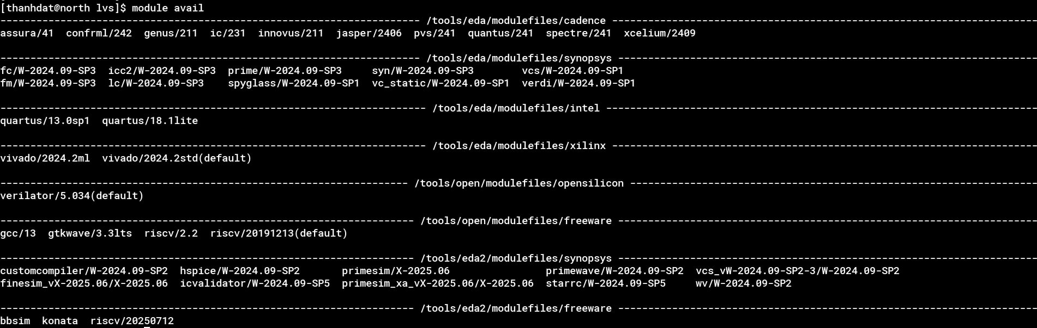
Design Flows
Synopsys Custom Compiler is a full-custom IC design environment optimized for analog, mixed-signal, and custom digital design. Similar to Virtuoso, Custom Compiler is designed for schematic and layout design, as well as DRC/LVS checks and more. Design Flow
Schematic Design
Tool: Custom Compiler
Pre-sim
Tool: PrimeWave
Layout
Tool: Custom Compiler
LVS/DRC check
Post-sim
Optimize
Simulator: Hspice/Primesim/ Finesime
Tool: IC Validator
Extraction Tool: starrc
Waveview: wv
According to the diagram, we must install the tools as mentioned in order to proceed with the design:
module avail to show the available tools
module load <tool_name> to install the tool
Examples:

Slide 4
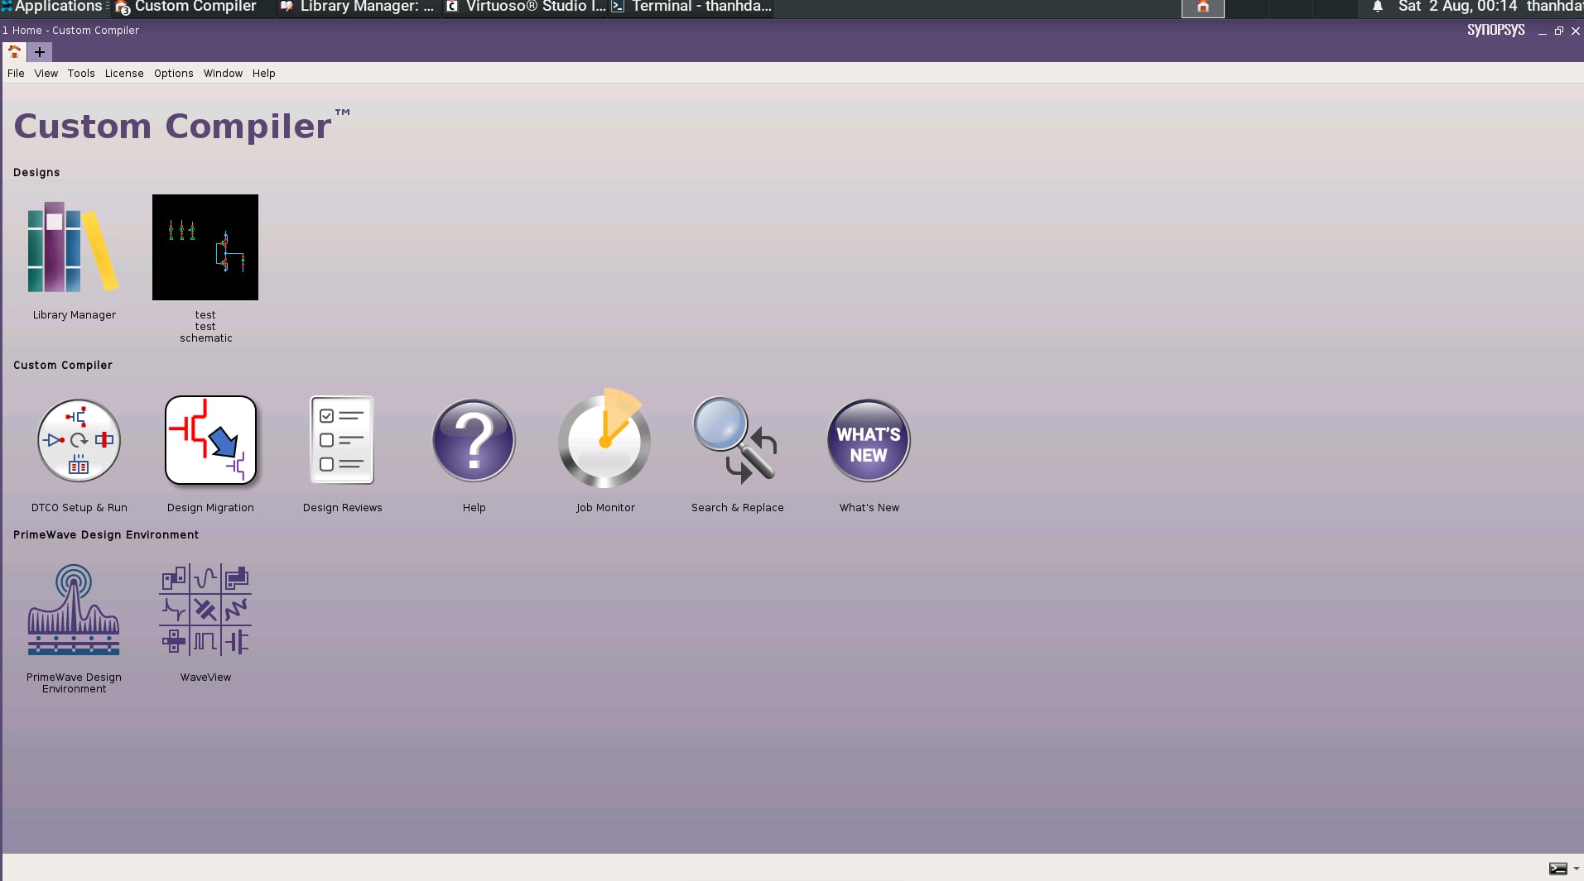
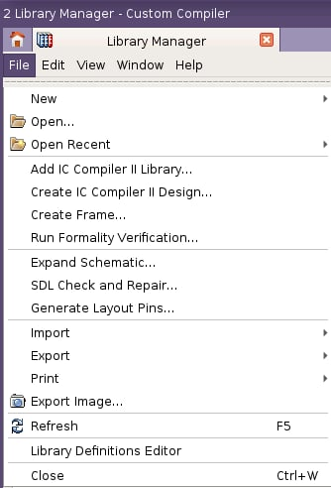
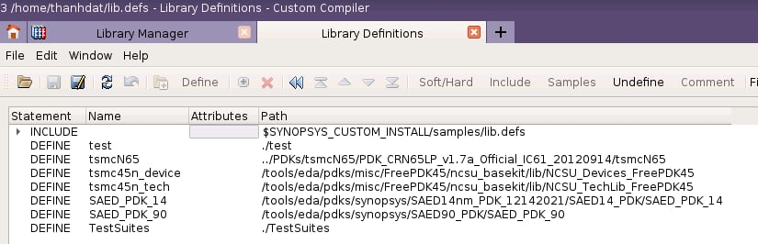
Circuit Design Flow
After installing the necessary tools, open Custom Compiler (CC) to start designing the circuit: custom_compiler &
Click on Library Manager to open the library management tool
In the Library Manager tab, open Library Definitions Editor to access lib.defs and import PDK
Library Manager

Slide 5
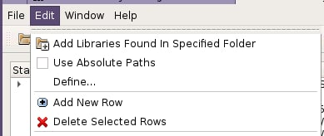
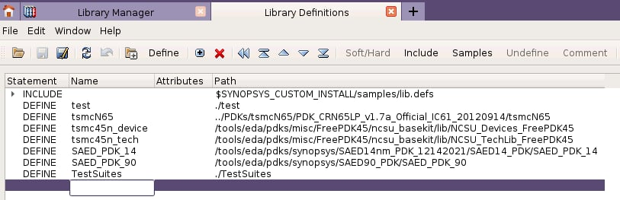
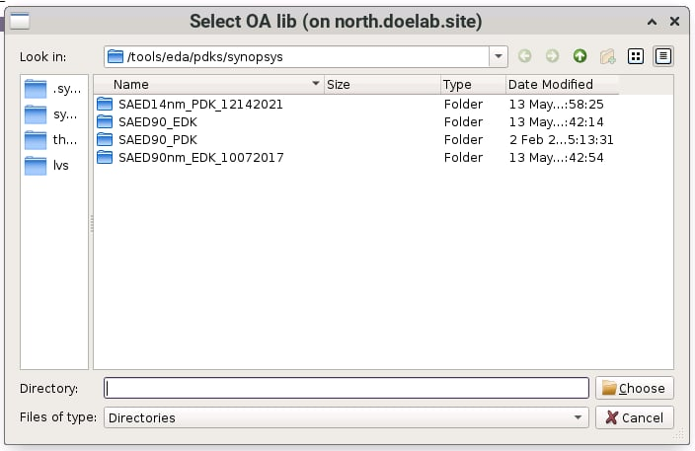
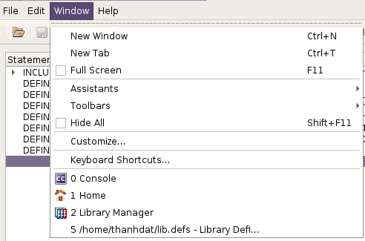
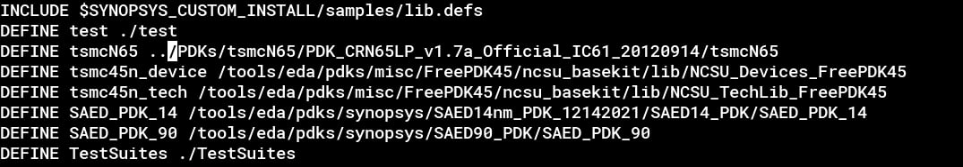
Circuit Design Flow
Import PDK
There is two methods to import PDK into Custom Compiler
Using Gui to import PDK
Click on the empty space below the last row
Choose Edit → Define ... → Choose the required PDK
Define PDK in the lib.defs file
3
2
1
In the window tab, there is the lib.defs dir. We can open it to import PDK

Slide 6
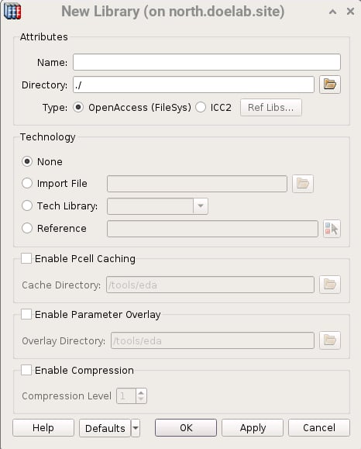
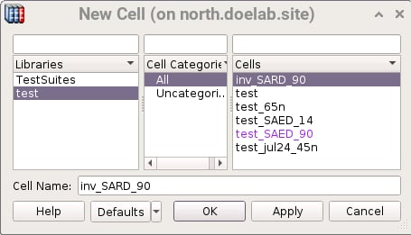
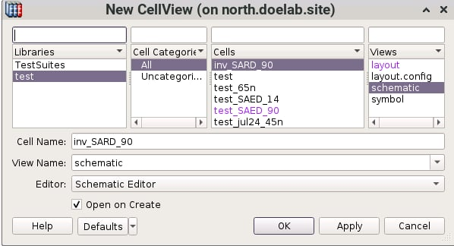
Circuit Design Flow
(1)
(2)
Schematic Design
In the Library Manager tab, choose
New → Library: create the new lib (1)
Name: Define the library name
New → Cell: create the new cell (2)
Cell Name: Define the cell name
New → CellView: create the new cellview (3)
View Name: Define the view name
Editor: Choose type of cellview, such as: Schematic Editor, Layout Editor,...
(3)

Slide 7
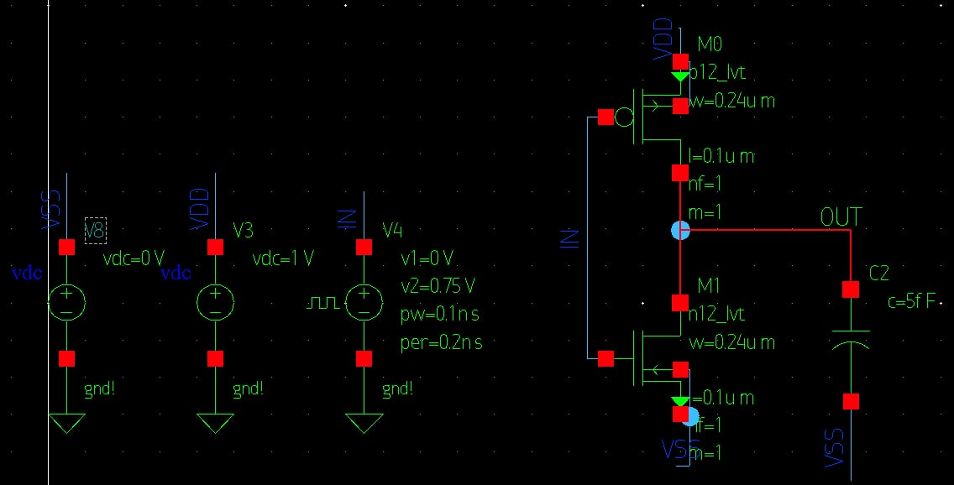
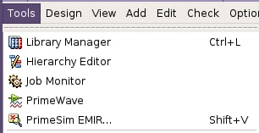
Circuit Design Flow
Schematic Design
In the Schematic editor, build a testbench, such as an inv:
Keyboard shortcuts similar to Virtuoso:
I: Add instance
W: Draw net
L: Name net
P: Add pin ...
After completing the schematic, select Tools → PrimeWave to simulate the circuit
Set up like as ADE L to run presim

Slide 8
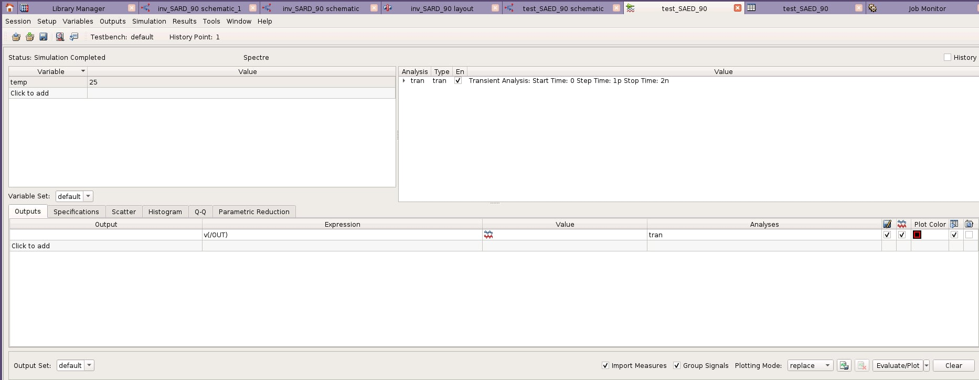
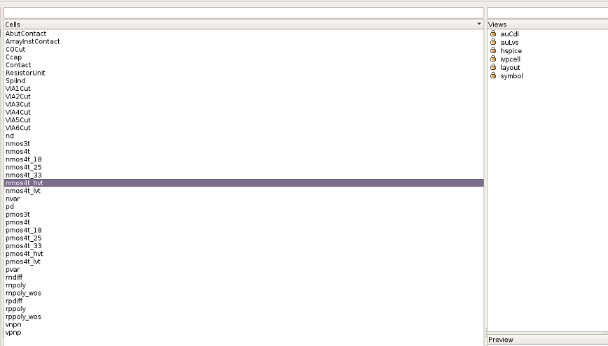
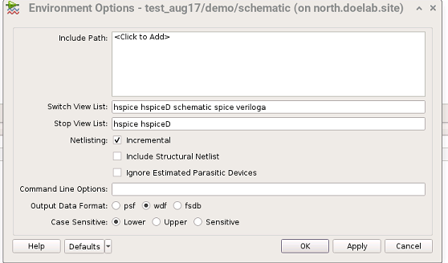
Circuit Design Flow
Schematic Design
Config the Primewave like as ADE L's config
Note: must observed the cell view of MOSFET to config in the environment option
Environment option

Slide 9
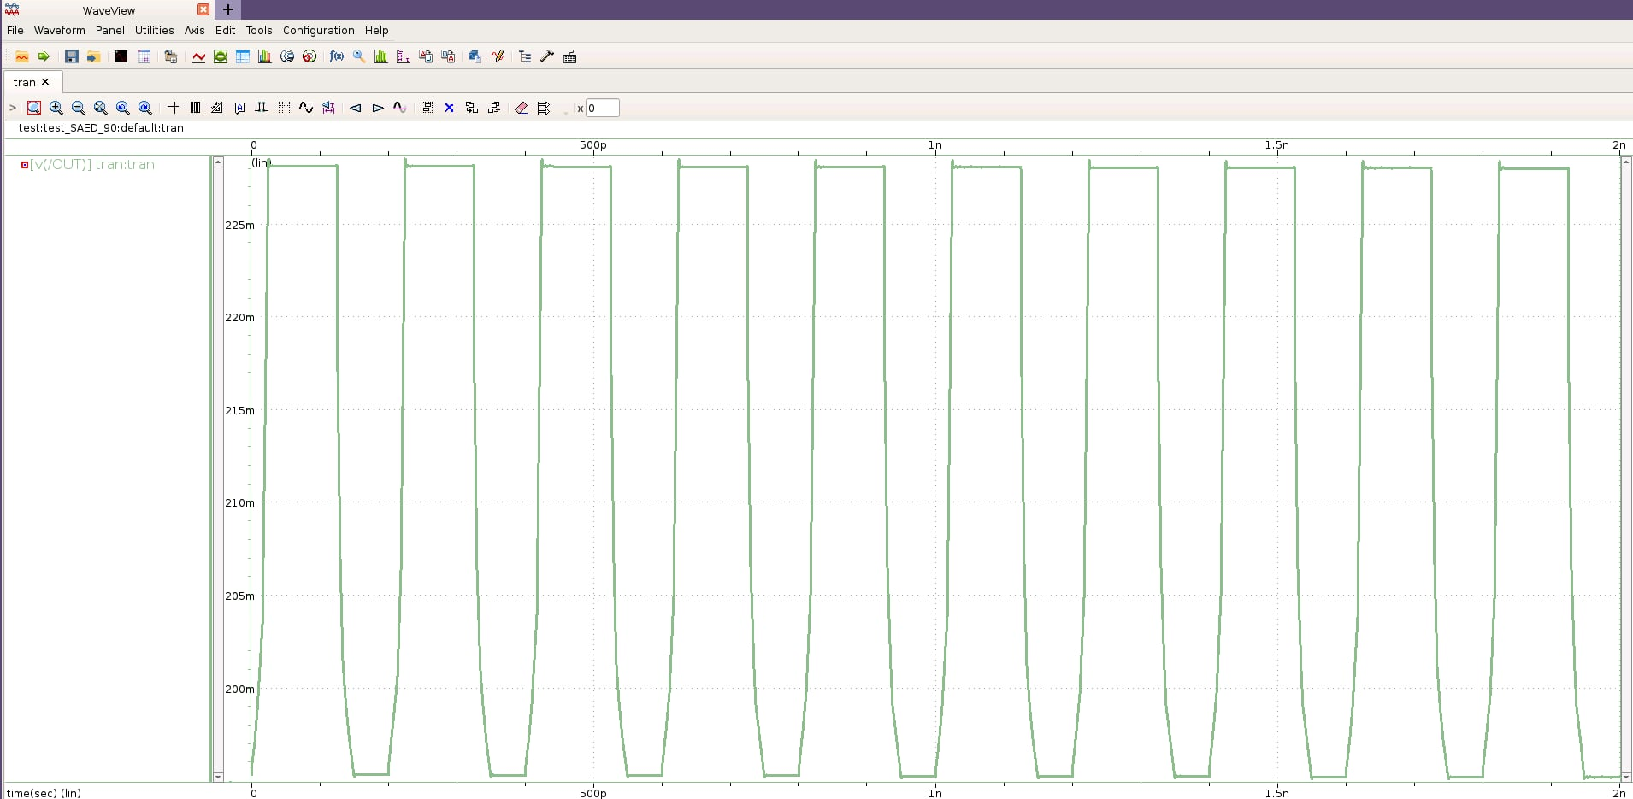
Circuit Design Flow
Schematic Design
We get the waveform at the output inv

Slide 10
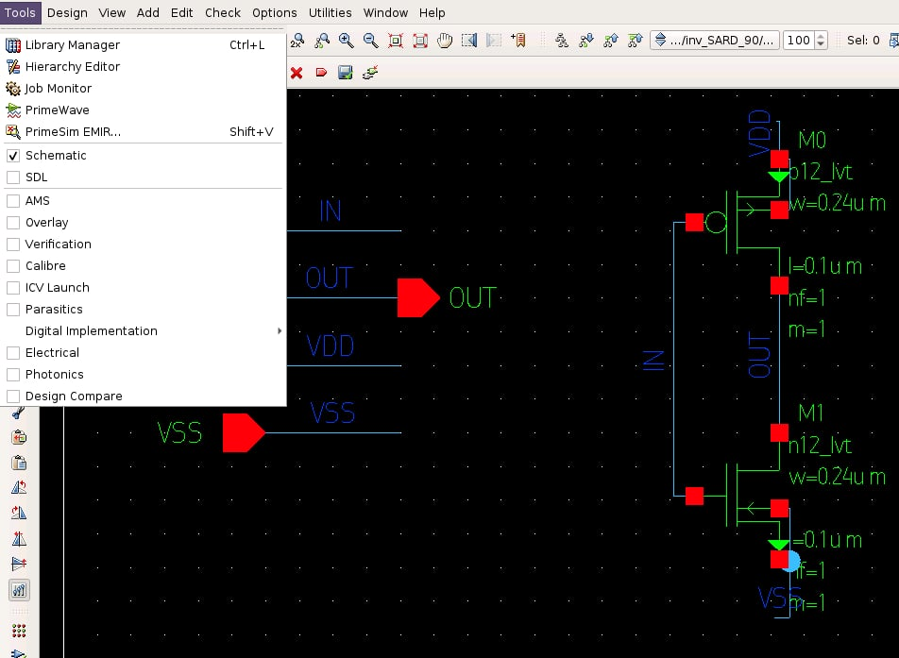
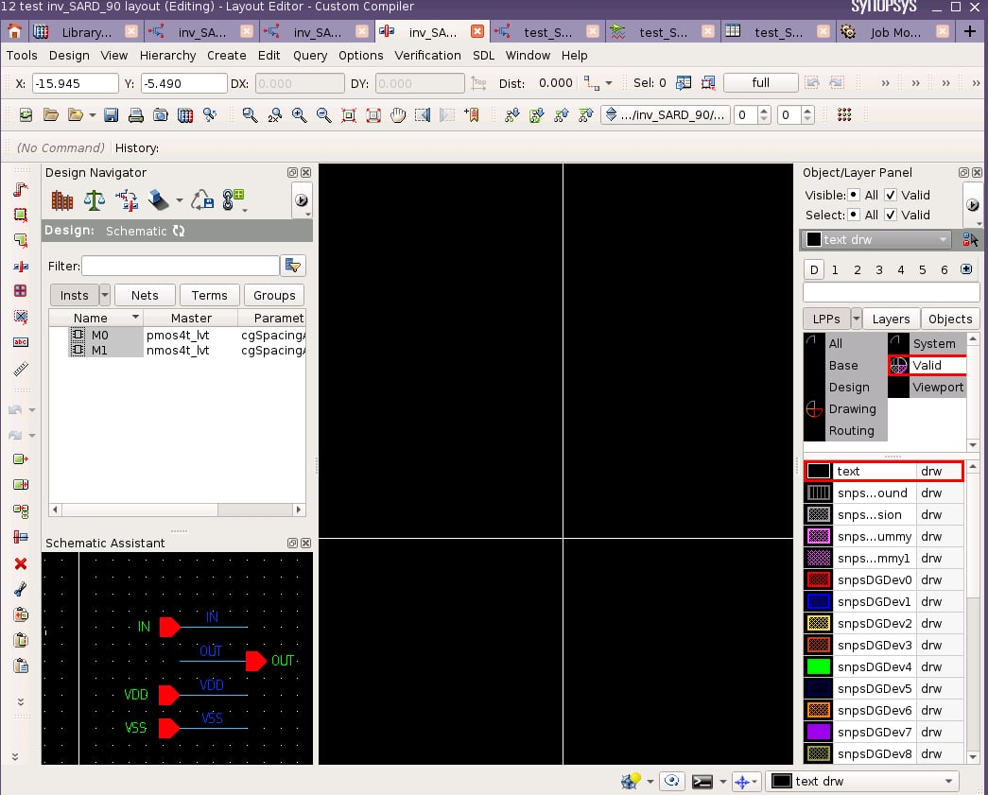
Layout Design Flow
Layout Design
After create the schematic of a cell, choose Tools → SDL to generate the layout view

Slide 11
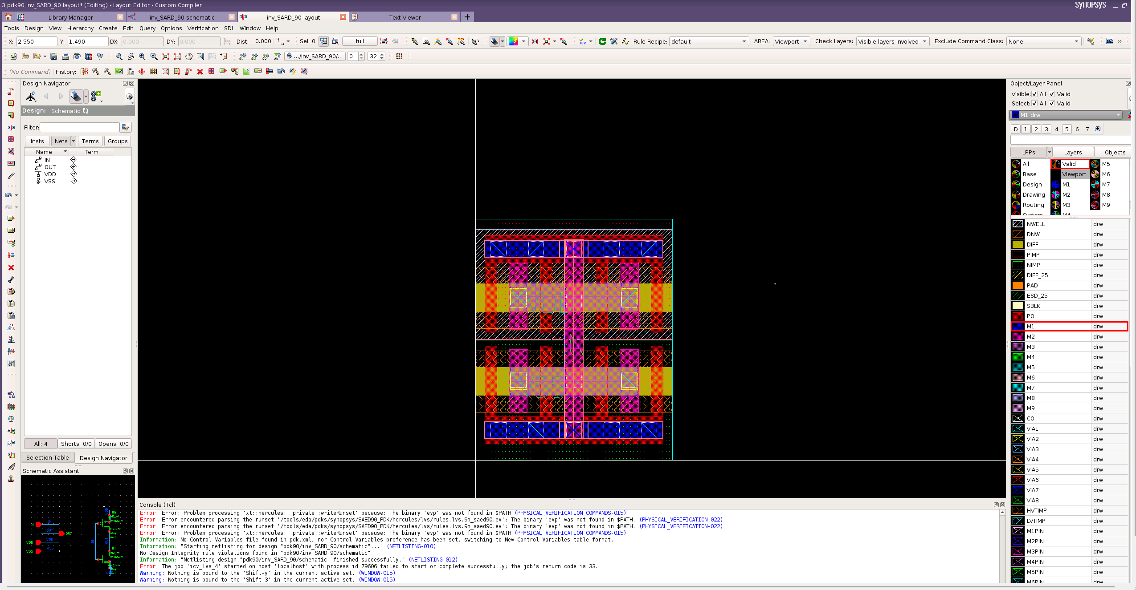
Layout Design Flow
Custom compiler guideline
Object Layer Panel: show object layer on canvas
Design Navigator Panel (works only in SDL mode): find/select instance or nets.
Toolbar: contain useful tool to create/edit instance or nets
Console: print information/error of commands
Canvas: Design area
Detail guideline in next slides

Slide 12
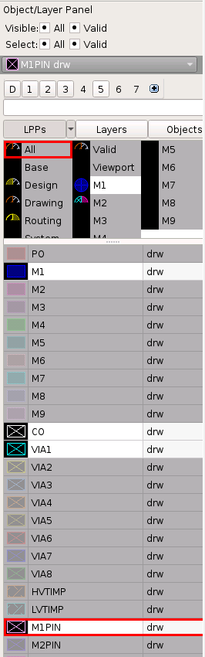
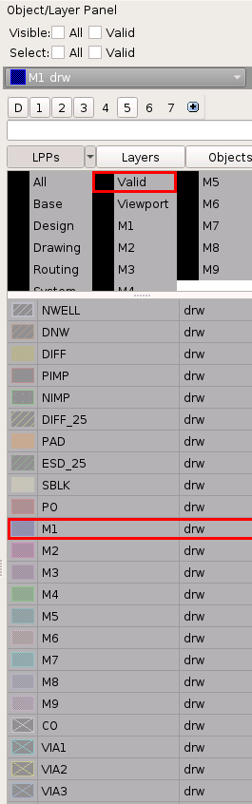
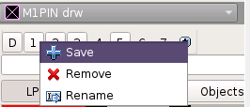

Layout Design Flow
Object Layer Panel
You can save list of layer map to display to presets.
After set preset, you can quickly show saved layer map list.
All: show all available layers
Base: show base layer
Design: show only layer used in current view of canvas
Each layer have 2 option:
Visible: if turn on, show that layer in canvas (left click to that layer)
Valid: if turn on, user can choose that layer instance (right click to layer name, middle button mouse to turn of visible+valid)
Right click of preset 1 and press save.
Then you can quickly show M1, M1PIN, C0, VIA1 by clicking preset 1
Ex:
M1: visible+valid
M2: visible but not valid
M3: not visible+valid
Choose list of layer: M1, M1PIN, C0, VIA1

Slide 13
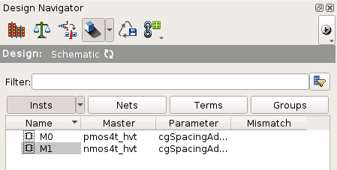
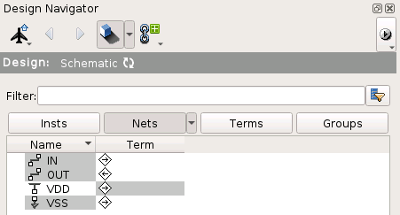
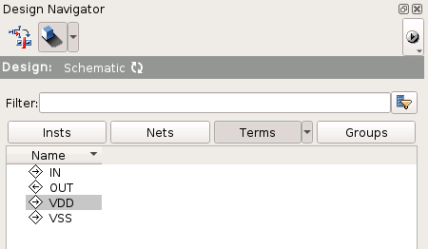
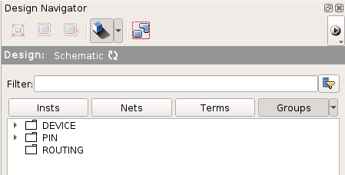
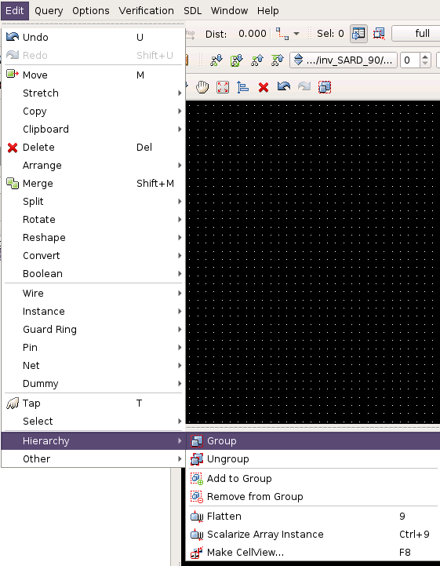
Layout Design Flow
Design Navigator
List out instance used in design
White label: instance in layout map with schematic
Gray label: instance in layout not map with schematic
You can click instance with gray label and click button Pick and place to add that instance to layour view
List out nets need to connect
Similar with instance:
In column Name:
White label: current net have connect correct with devices
Gray label: current net have not connect correct with devices (open net/short net)
In column Term:
White label: current net have correct pin and label
Gray label: current net miss pin/label
Similar with column Term in tab Nets
List group of instance/net in design
You can collect multiple instances/nets into a group for easy to review and update.
Choose instance/nets want to group and choose Edit->Hierachy-> Group

Slide 14
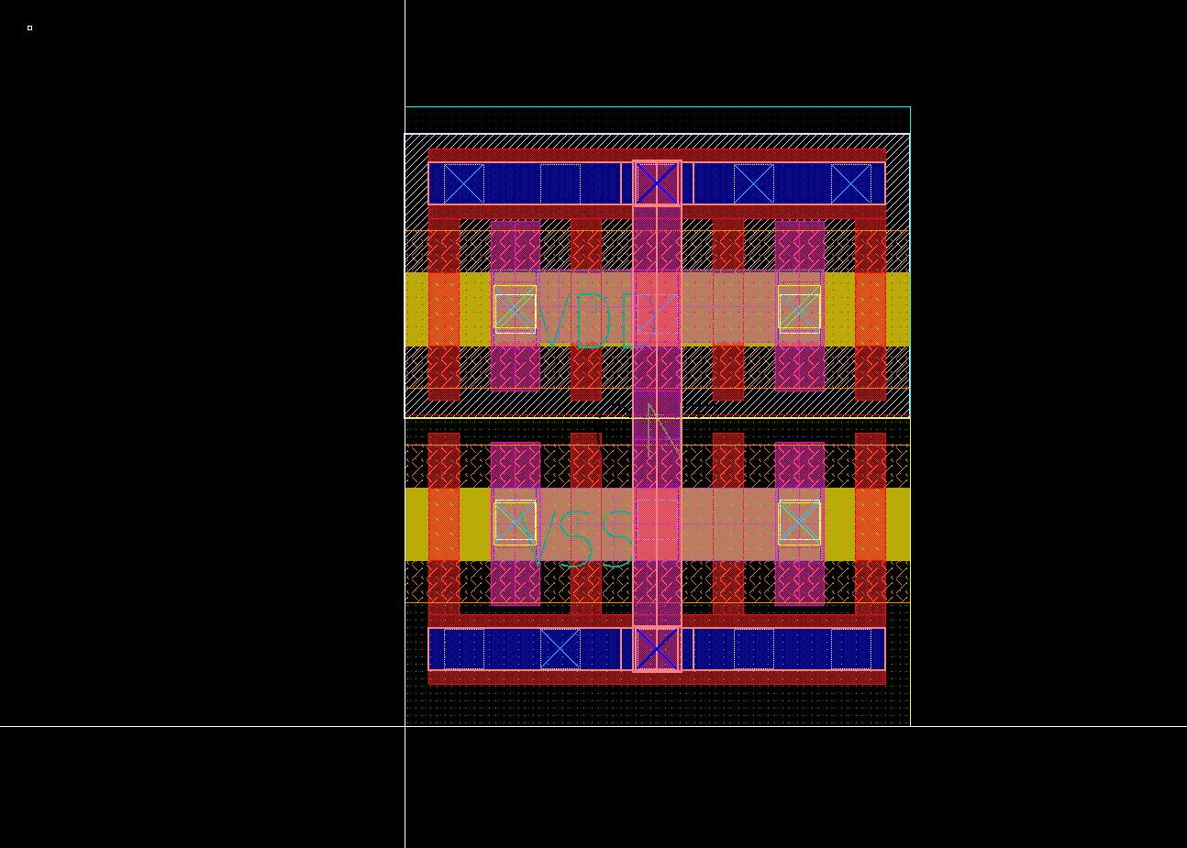
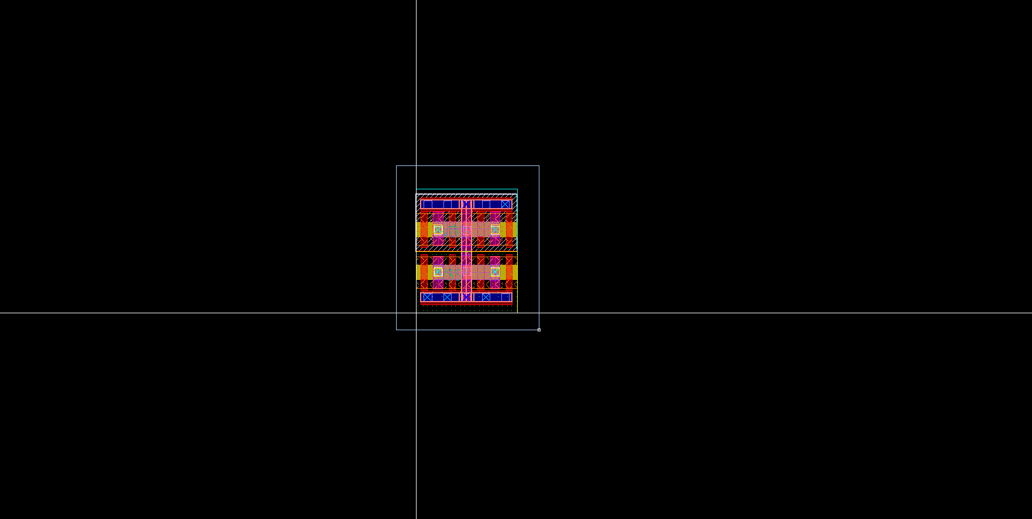
Layout Design Flow
Canvas - Zoom
Display layout view of design.
Common command:
Zoom:
drag+drop right mouse to select area you want to zoom in
Scroll up/down to zoom in/out
Press F to auto fit area

Slide 15
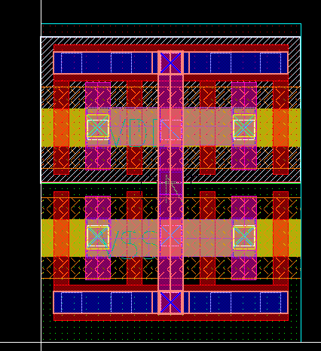
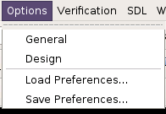
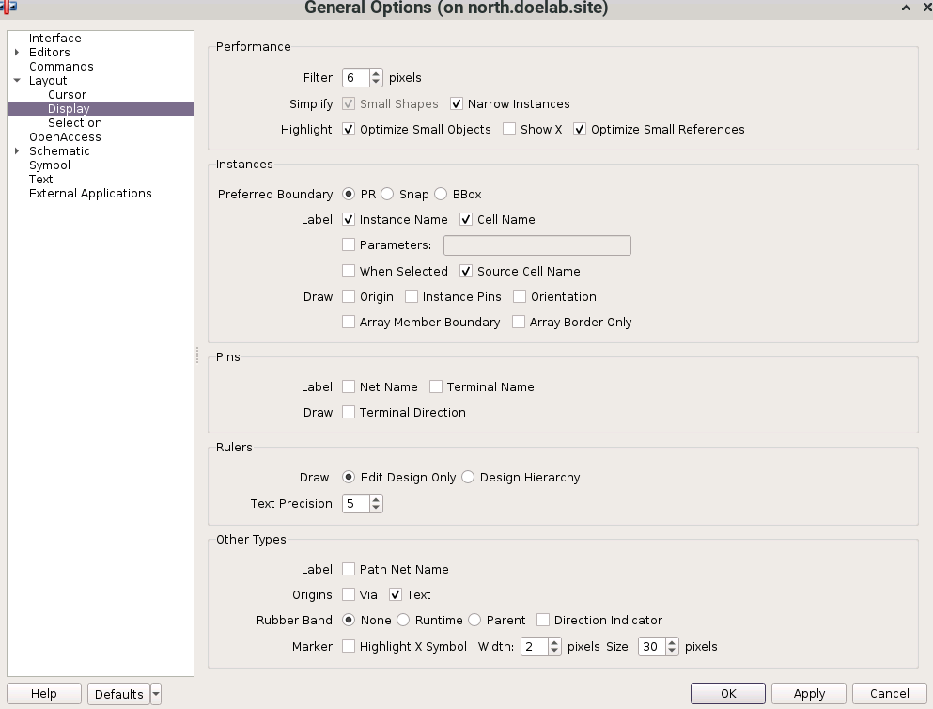
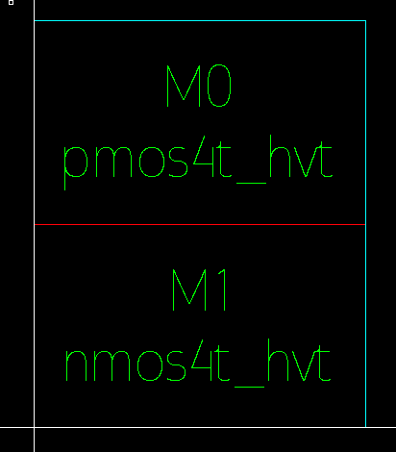
Layout Design Flow
Canvas – Floorplan
Common command:
Option -> General -> tick Cell Name -> OK
Ctrl+F to change view to show only boundary and instance/cell name of subcell
-> Easy to Floorplan

Slide 16
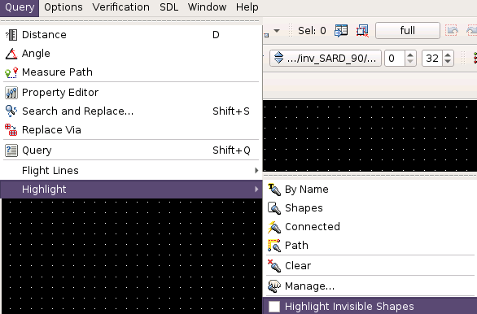
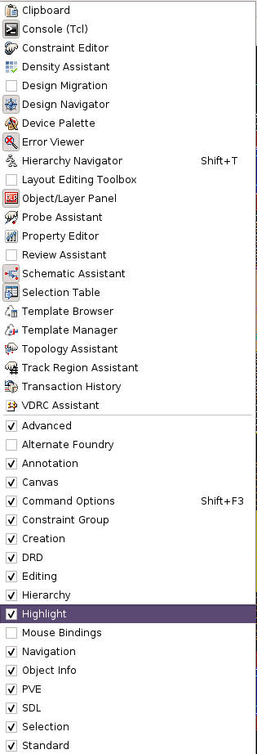

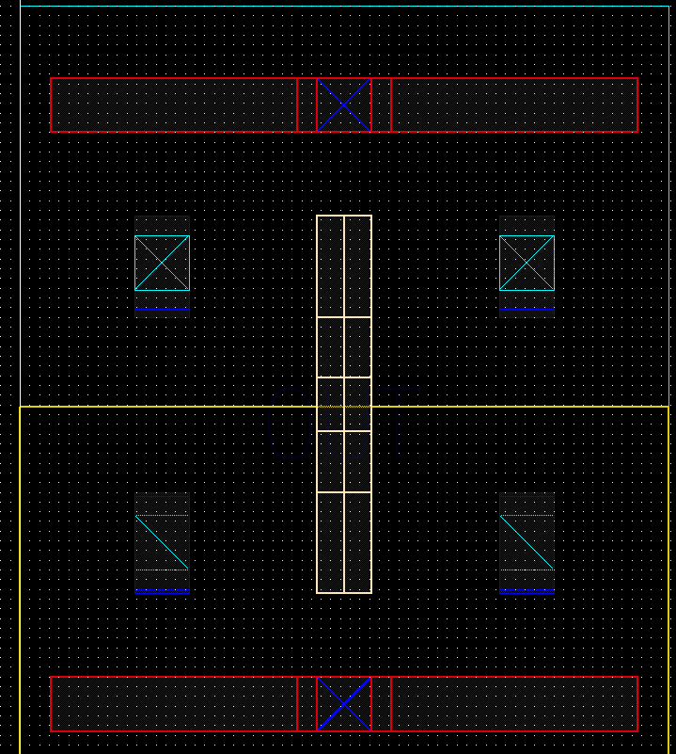


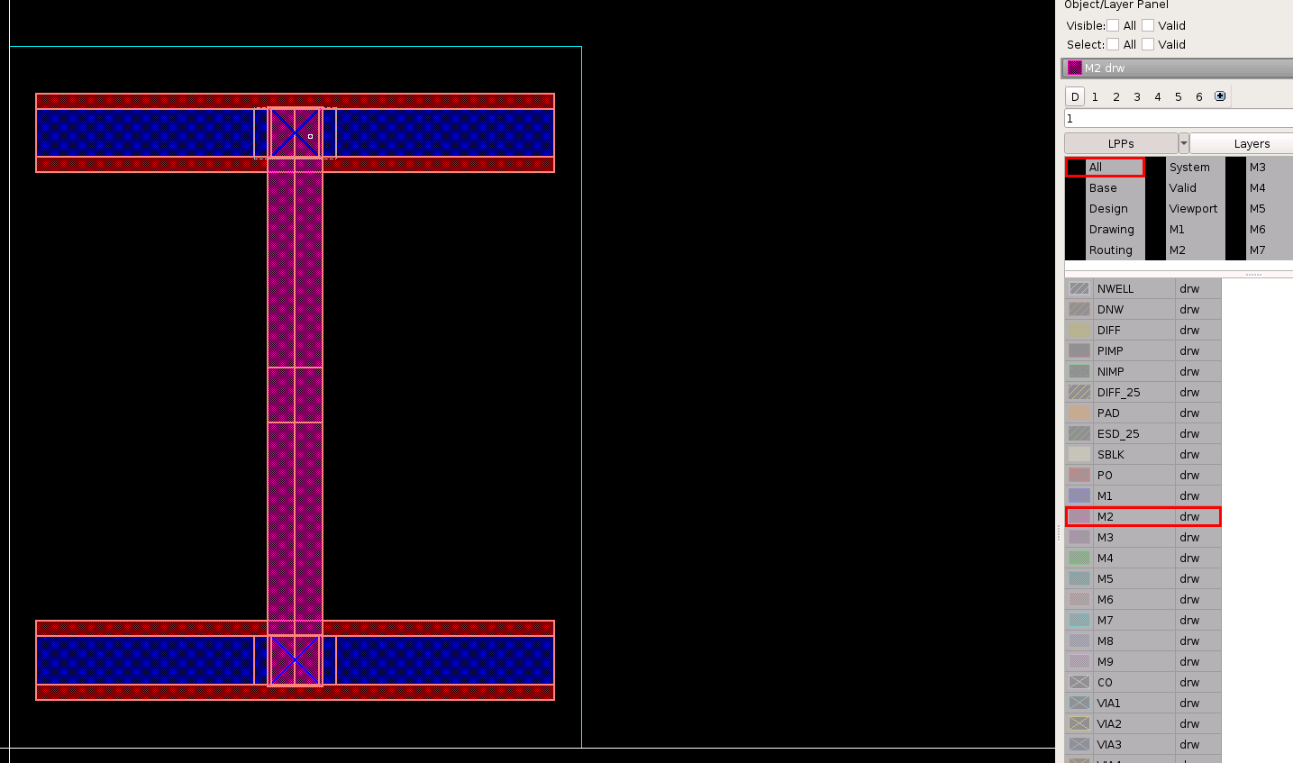
Layout Design Flow
Toolbar – Highlight
Input net with red border
Highlight button now appear on toolbar
Enable Cross Shadow and change color
You can tick Highlight Invisible shapes to highlight all shapes in connected path
Output net with white iborder
Click Highlight Connected button and choose a net , tool will highlight all metal/via connect to that net
Input net with red border
Right click on toolbar and tick Highlight
No visible layer but tool still highlight all layer in connected path

Slide 17
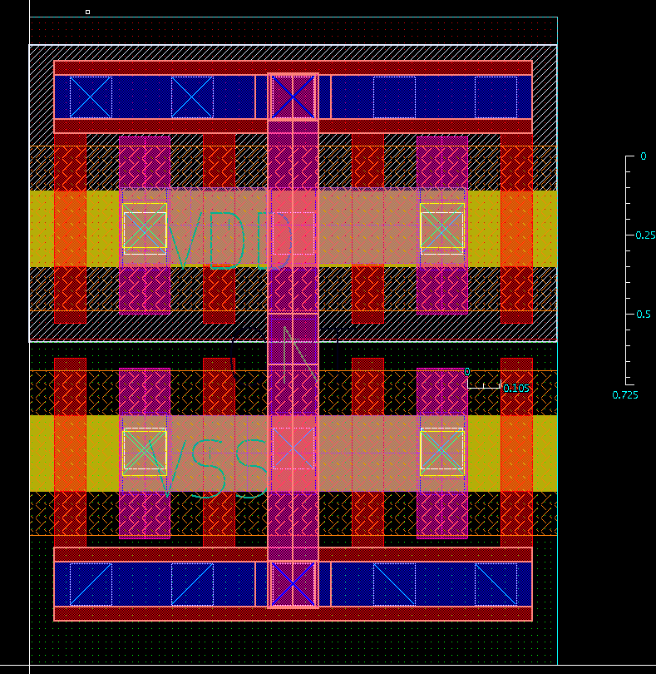
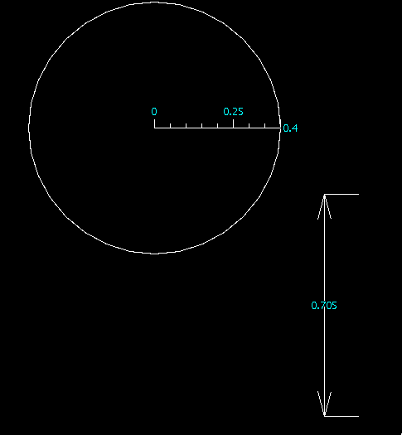
Layout Design Flow
Toolbar – Ruler
Press K and click 2 points to measure distance between those points
Press D and click 2 edges of shapes to measure the distance between those edge
You can tick to Track/Midpoint to measure distance between track/midpoint of shapes
Or change ruler type to change to other type
You can delete all ruler by pressing Ctrl+K
Output net with white iborder

Slide 18
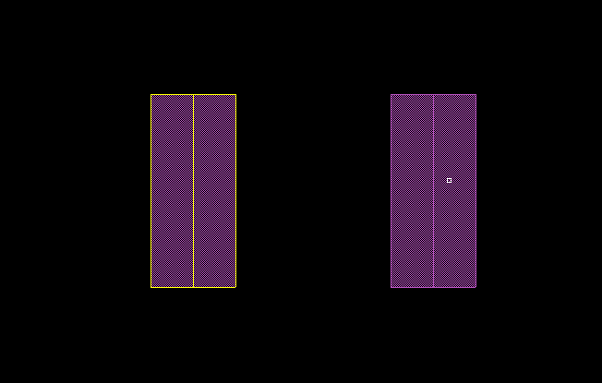
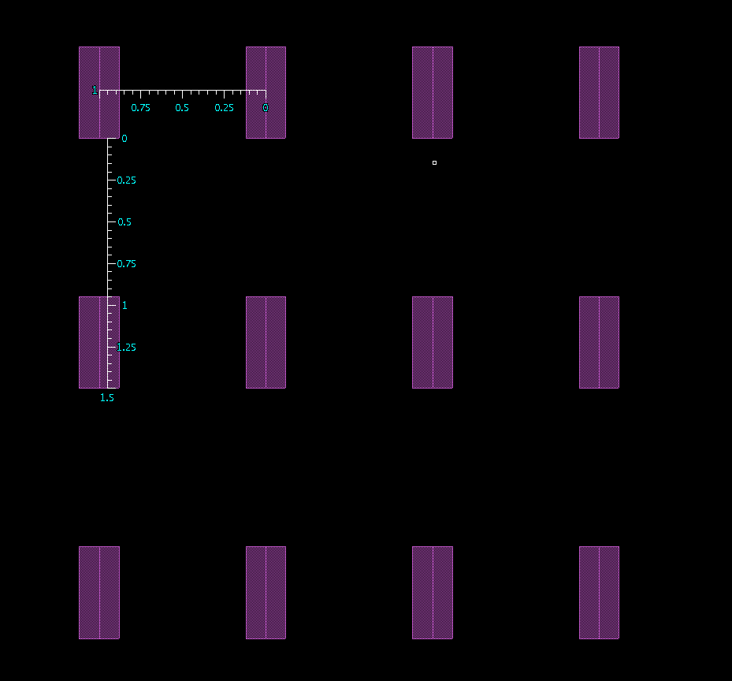
Layout Design Flow
Toolbar – Copy
Step: choose shapes/instance you want to copy, then press C place to destination
when press C to copy, tool provide you some option in toolbar
Output net with white iborder
-> very helpful when drawing power mesh

Slide 19

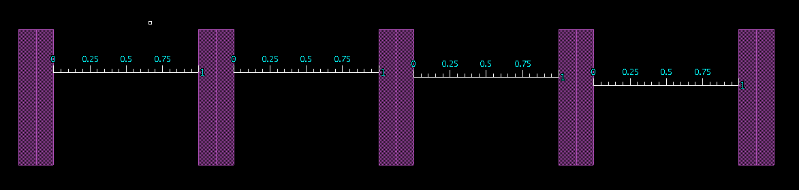
Layout Design Flow
Toolbar – Create path
Press P, click to start point in canvas.
Click left mouse to make a curve
Double click left mouse to finish the path
Create bus:
Press Ctrl + I
Enter the number of bits and W/L you want then do similar with create path
-> very helpful when drawing power mesh

Slide 20
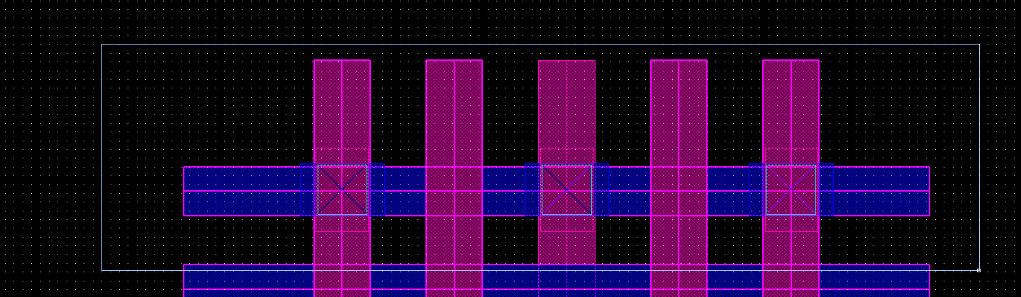
Layout Design Flow
Toolbar – Create via
Press O
Can choose between auto and manual
Nets: enter net name you want to drop via (to avoid short net)
Only same net: drop via for only net with same name
VDD
VDD
VDD
VDD
Tool only drop via on interconnect of net VDD

Slide 21
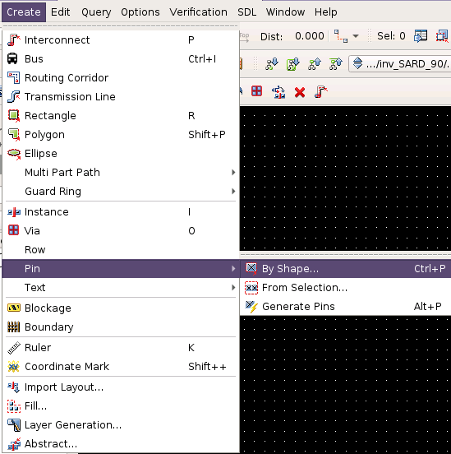
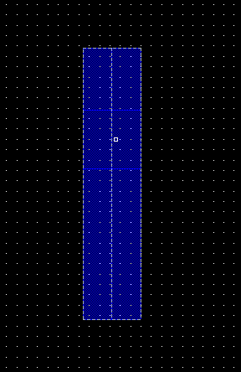
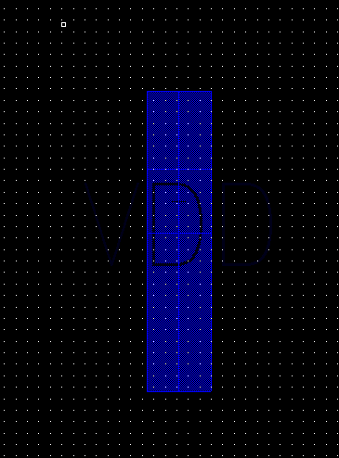
Layout Design Flow
Toolbar – Create pin
Select shape -> create -> Pin -> By shape
Enter Pin name
Choose position of pin

Slide 22
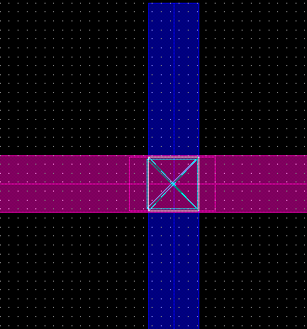
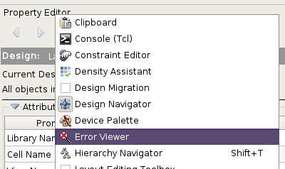

Layout Design Flow
Toolbar – Error viewer
Check and highlight short nets, very helpful when clean lvs

Slide 23


Layout Design Flow
Toolbar – Shortcut
Function | Key
Copy | C
Move | M
Add instance | I
Rotate (only affect when move/copy) | R
Undo | U
Align | 4
Trim | 7
Fit view | F
Deselect | Ctrl+D
Change to border view | Ctrl+F/Shift+F
View Property | Q
Add bus | Ctrl+I
Distance | D
Ruler | R
Delete all ruler | Shift+K
flattern | 9
Chop | Shift+C
Merge | Shift+M
You can modify your own shortcut

Slide 24
Layout Design Flow
Layout Design
After create the schematic of a cell, choose Tools → SDL to generate the layout view
TBU

